Slide 1
TRI Update: NAcc Regression Model Recovery
June 17, 2025

Slide 2
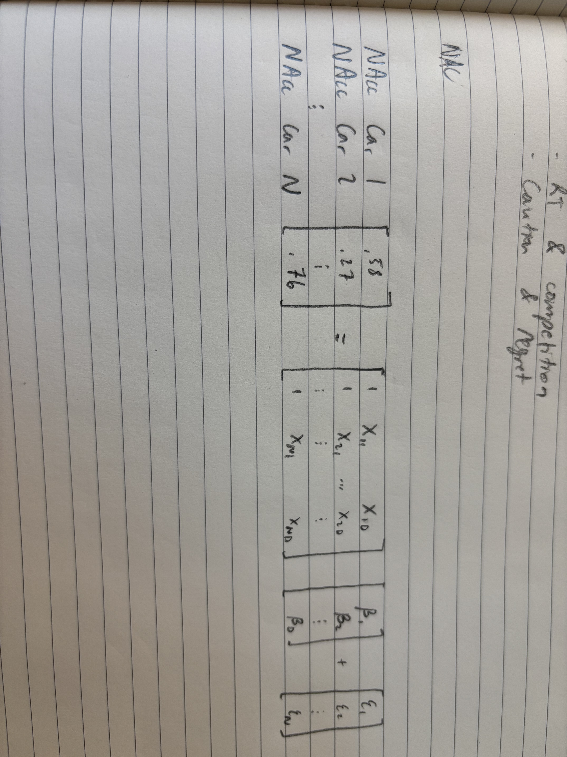
Next Steps
What latent dimensions correlate with NAcc activity?
Use latent traversal surveys to give interpretation to the significant dimensions.
Design NAcc-inspired surveys (e.g. judgements about these significant features). Outperform hypothetical purchasing decisions and liking ratings?

Slide 3
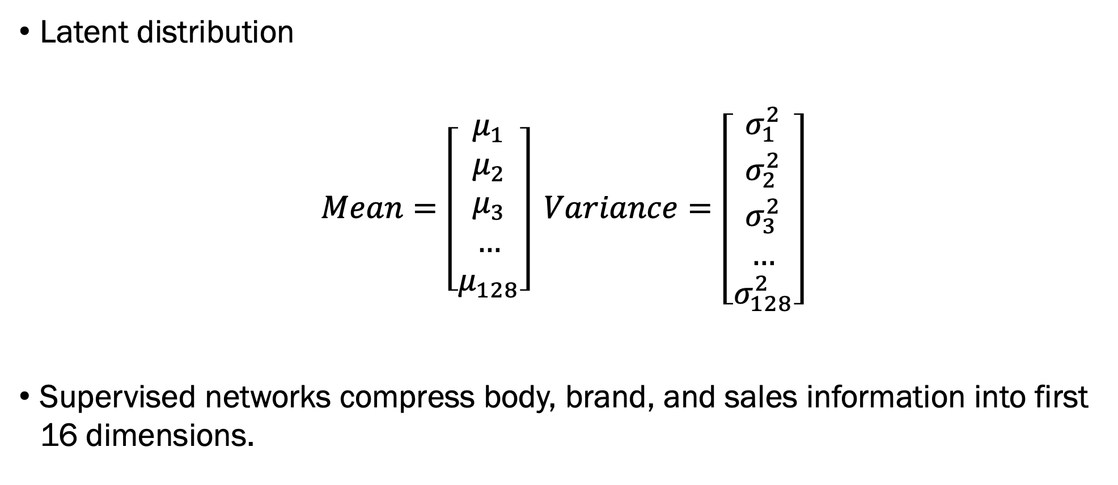
Problem: How do we regress NAcc activity on our latent distribution?
Latent distribution
$$Mean=\left[\begin{matrix}μ_{1} \\ μ_{2} \\ μ_{3} \\ … \\ μ_{128}\end{matrix}\right] Variance=\left[\begin{matrix}σ_{1}^{2} \\ σ_{2}^{2} \\ σ_{3}^{2} \\ … \\ σ_{128}^{2}\end{matrix}\right]$$
Supervised networks compress body, brand, and sales information into first 16 dimensions.

Slide 4
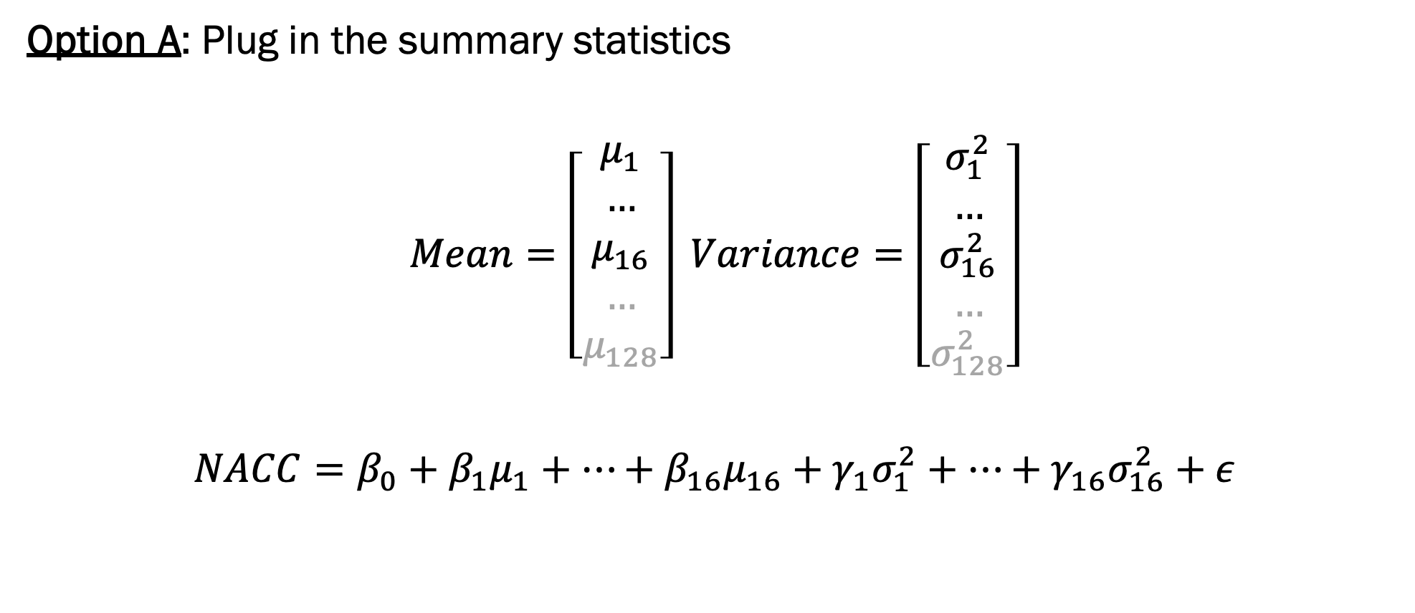
Problem: How do we regress NAcc activity on our latent vectors?
Option A: Plug in the summary statistics
$$Mean=\left[\begin{matrix}μ_{1} \\ … \\ μ_{16} \\ … \\ μ_{128}\end{matrix}\right] Variance=\left[\begin{matrix}σ_{1}^{2} \\ … \\ σ_{16}^{2} \\ … \\ σ_{128}^{2}\end{matrix}\right]$$
$$NACC=β_{0}+β_{1}μ_{1}+…+β_{16}μ_{16}+γ_{1}σ_{1}^{2}+…+γ_{16}σ_{16}^{2}+ε$$

Slide 5

Problem: How do we regress NAcc activity on our latent vectors?
Option B: Sample from the latent distribution
$$Mean=\left[\begin{matrix}μ_{1} \\ … \\ μ_{16} \\ … \\ μ_{128}\end{matrix}\right] Variance=\left[\begin{matrix}σ_{1}^{2} \\ … \\ σ_{16}^{2} \\ … \\ σ_{128}^{2}\end{matrix}\right]$$
$$Sample_{1}=\left[\begin{matrix}v_{1,1} \\ v_{1,2} \\ … \\ v_{1,16}\end{matrix}\right]Sample_{2}=\left[\begin{matrix}v_{2,1} \\ v_{2,2} \\ … \\ v_{2,16}\end{matrix}\right] … Sample_{N}=\left[\begin{matrix}v_{N,1} \\ v_{N,2} \\ … \\ v_{N,16}\end{matrix}\right]$$
$$NACC=β_{0}+β_{1}v_{.,1}+β_{2}v_{.,2}+…+β_{16}v_{.,16}+ε$$

Slide 6


Simulate Data
Simulate latent vectors.
$$\left[\begin{matrix}v_{1,1} v_{1,2} v_{1,3} v_{1,4} \\ v_{2,1} v_{2,2} v_{2,3} v_{2,4} \\ … \\ v_{C,1} v_{C,2} v_{C,3} v_{C,4}\end{matrix}\right]$$
Simulate NAcc activity using some latent vectors.
$$NAcc=1+2v_{.,1}+3v_{.,2}+ε$$
4 latent dimensions
C cars
$$v_{.,.}∼N(0,1)$$

Slide 7
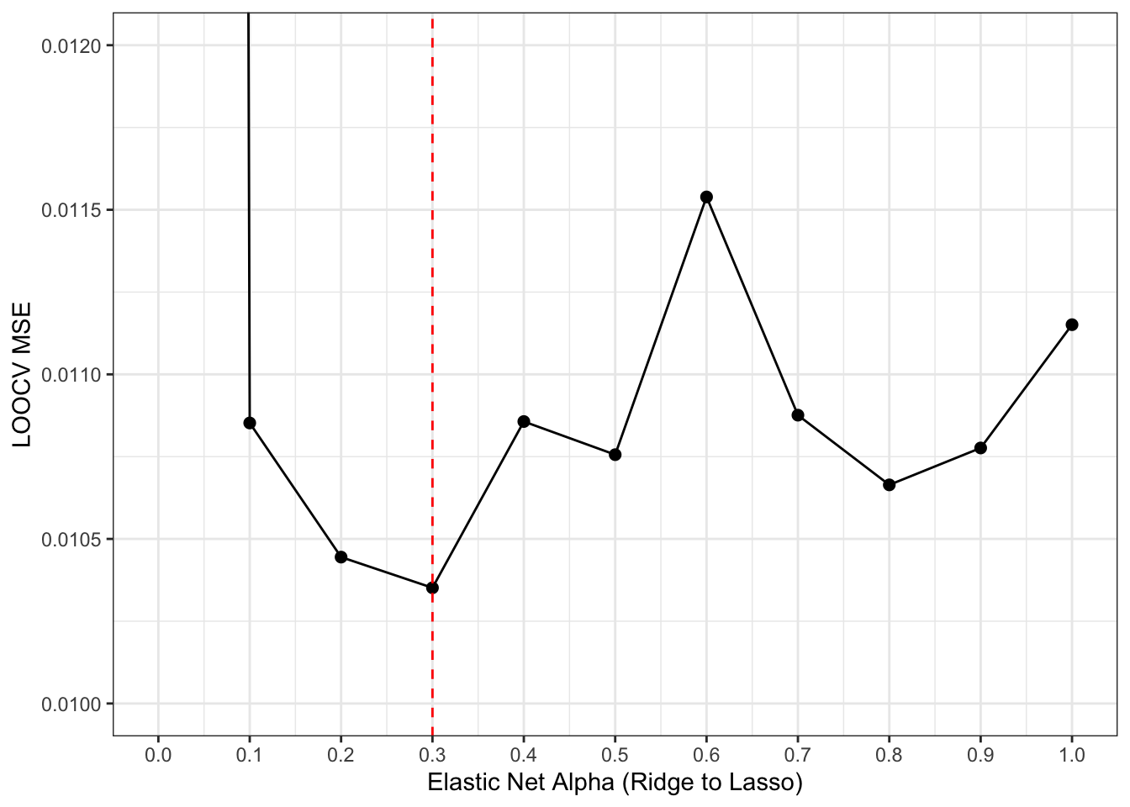
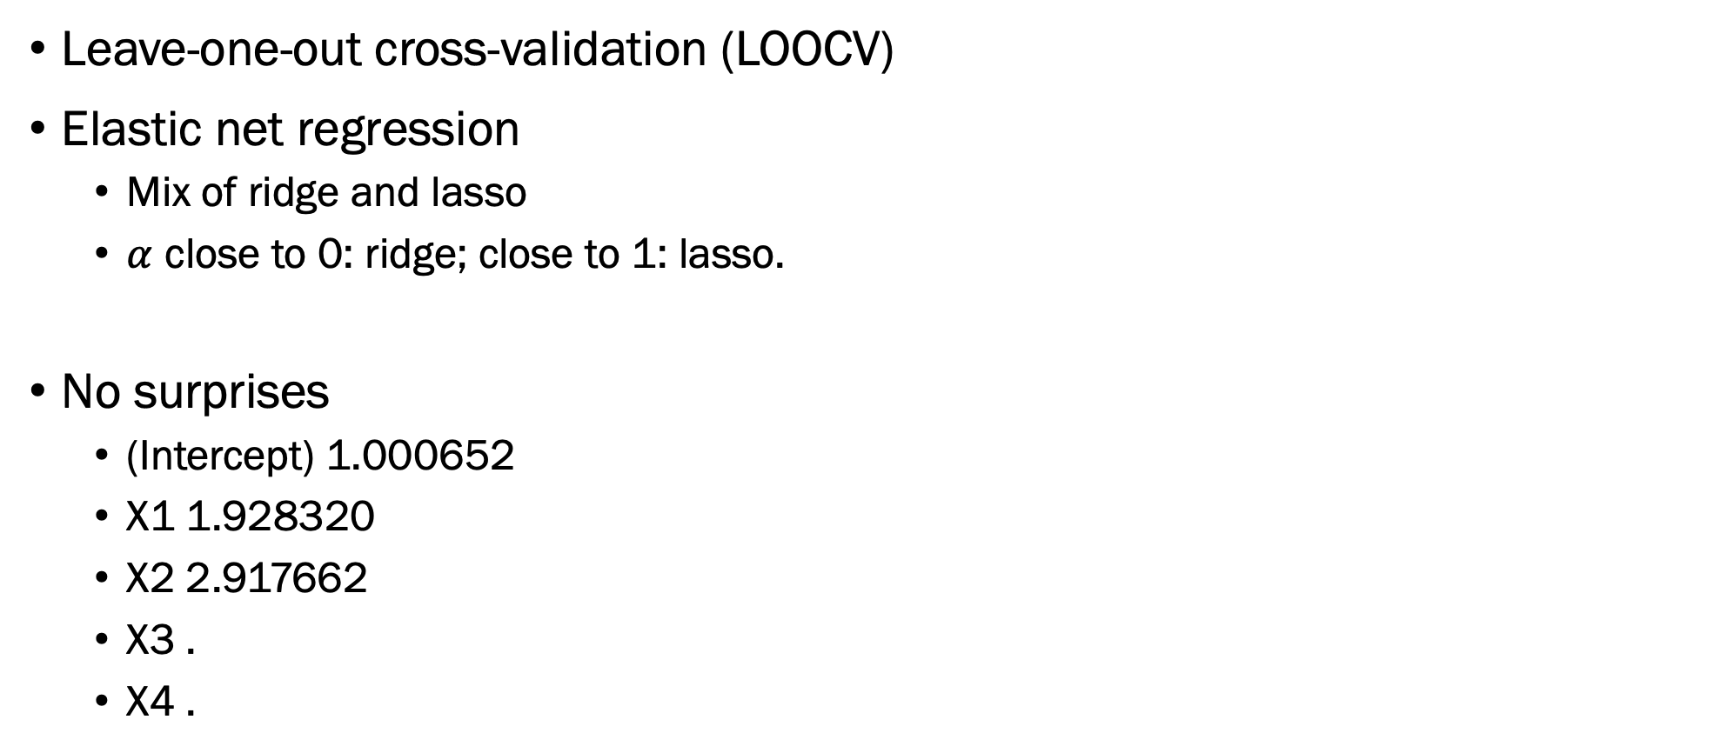
Case 0: Using true latent vectors
Leave-one-out cross-validation (LOOCV)
Elastic net regression
Mix of ridge and lasso
$α$ close to 0: ridge; close to 1: lasso.
No surprises
(Intercept) 1.000652
X1 1.928320
X2 2.917662
X3 .
X4 .

Slide 8
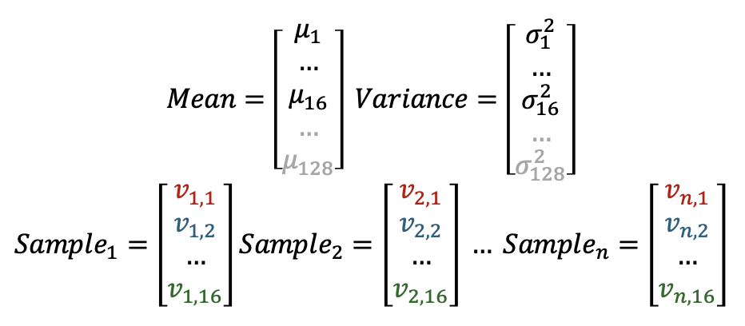
Case 1: Sampling w Precise Means
Fix latent sd to {0.2, 0.5}.
Latent mean for each car is equal to its actual value at that dimension.

Slide 9
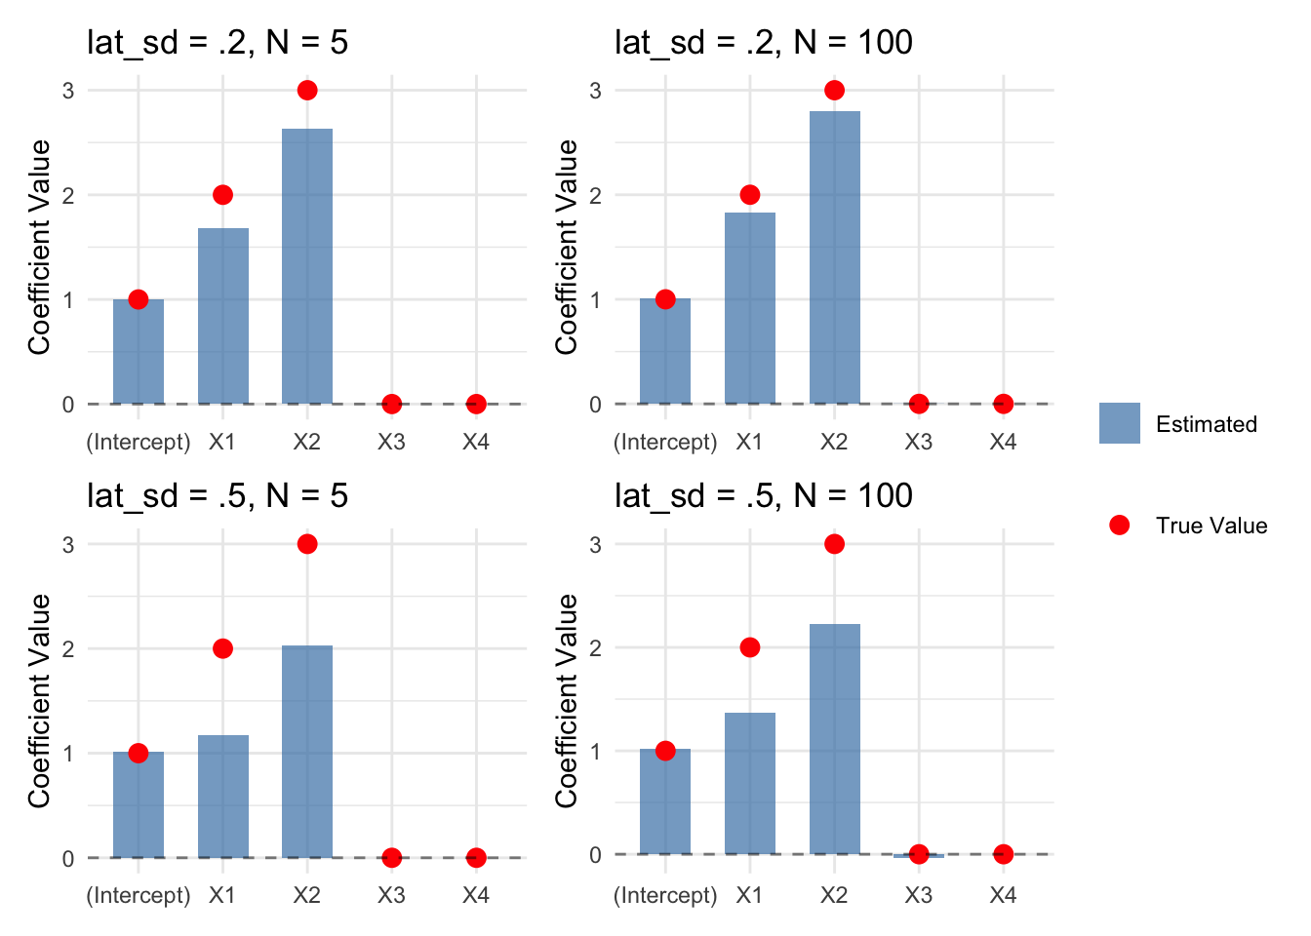
Case 1: Sampling w Precise Means

Slide 10
Case 2: Sampling w Noisy Means
What if our latent means are not centered on the true latent value of the car? We introduce noise to the mean, lat_mu_noise.
Theoretically, this should be the same thing as adding noise to the latent distribution. This is because X~N(m1, v1), where m1~N(m2, v2), is the same as X~N(m2, v1+v2).

Slide 11
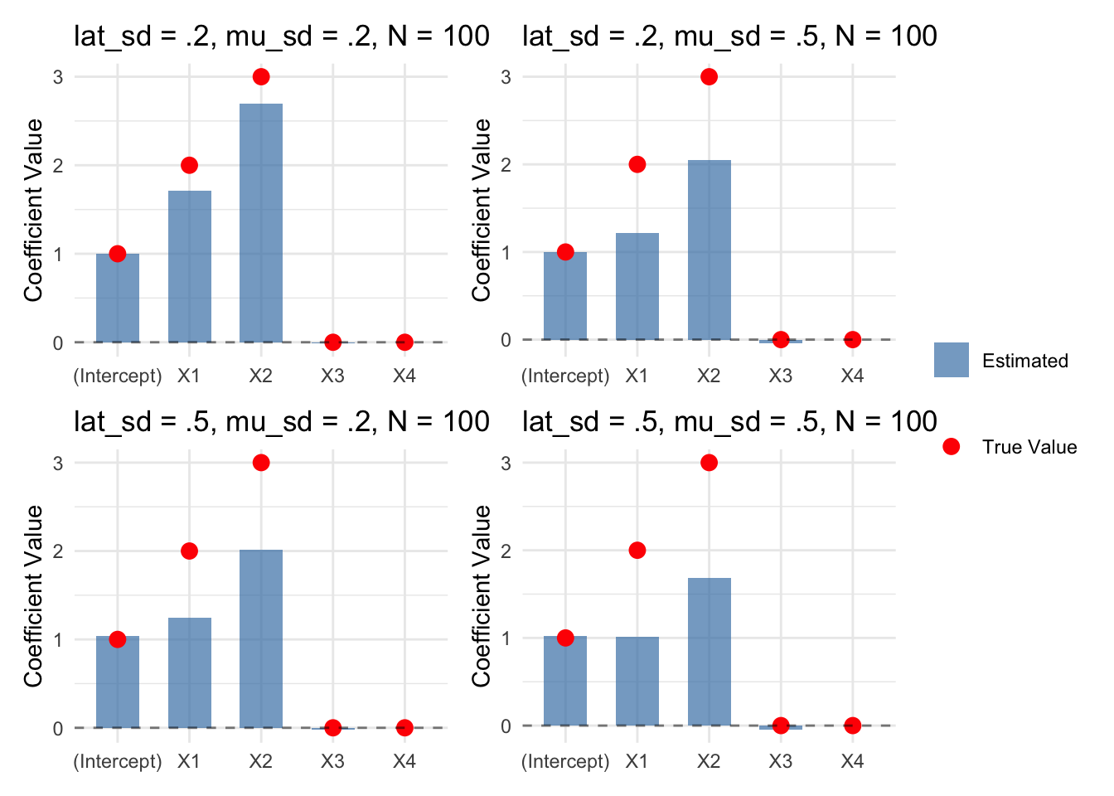
Case 2: Sampling w Noisy Means

Slide 12
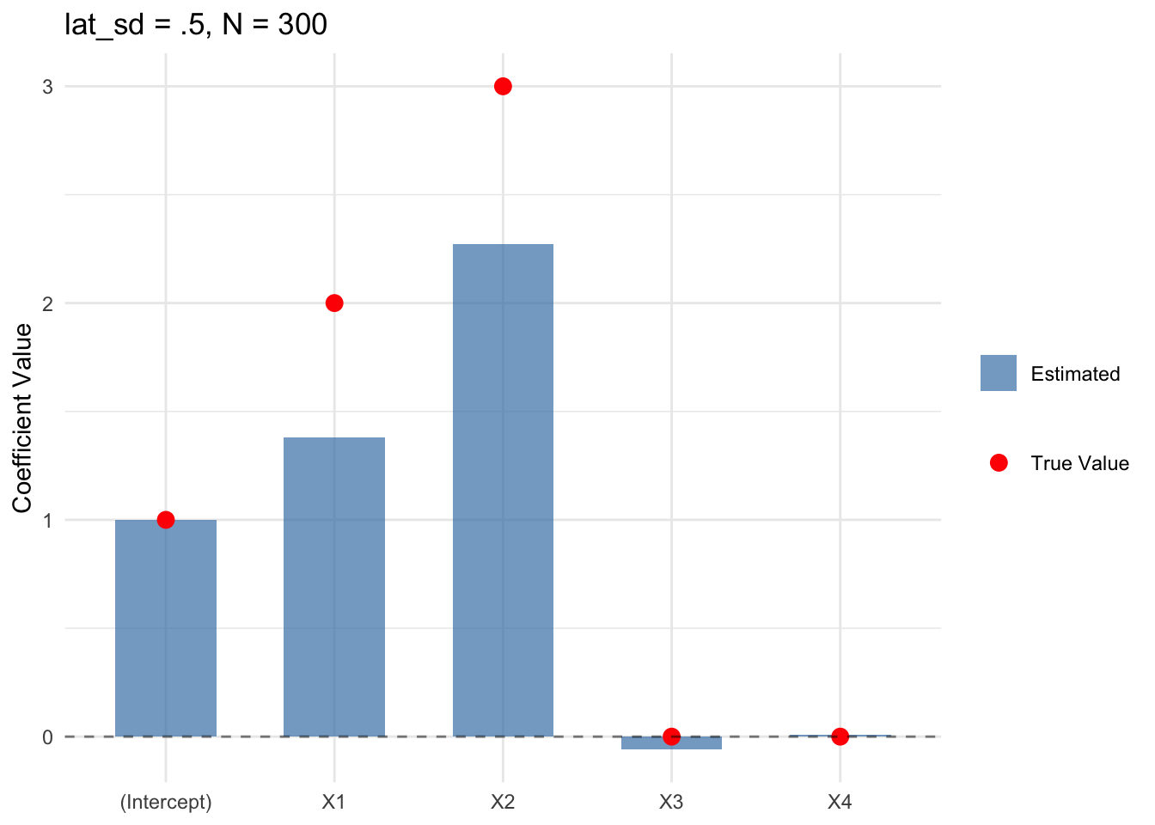

More samples? Uneven latent variances?

Slide 13
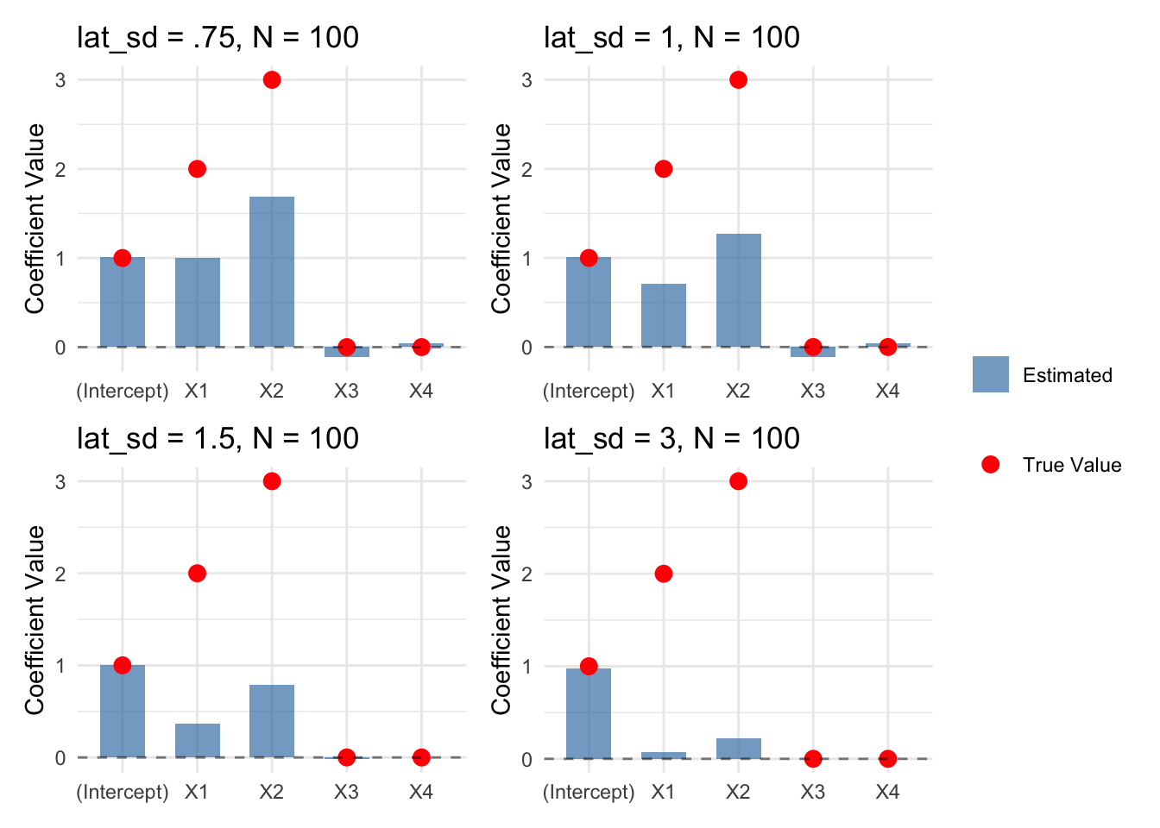
Limit of latent variance?

Slide 14
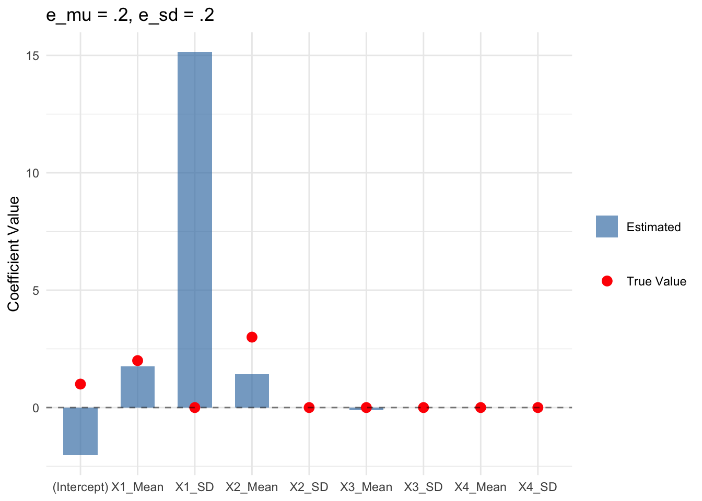
Case X: Latent summary stats as regressors
Added some noise to the true latent summary stats before regression.
No bueno.

Slide 15
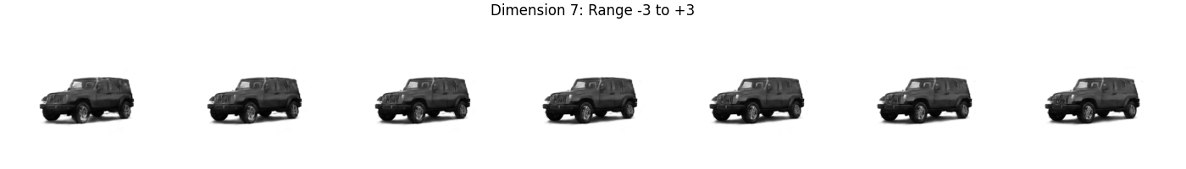
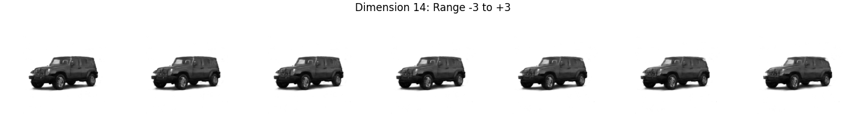
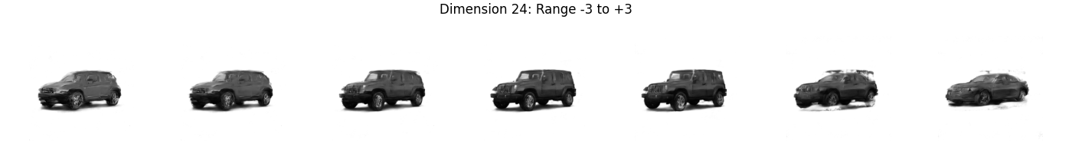
Extras: Latent Traversals

Slide 16
Next Steps
Incorporating a supervised network that takes samples from the first 16 dimensions of the latent distribution and tries to predict sales data for each year-make-model. This should force the first 16 dimensions to capture some visual elements that predict sales.
Can use a diffusion network to clean up the latent traversals.

